Slide 1

mooDSpHERE
An Emotion Based Music Recommender

Slide 2



Agenda
Project Description
Problem Statement
Team Member & Roles
Personas
Market Analysis
Market Challenges
Timelines
Technology Description
Retrospective
Teamwork Agreement
Wiki page link

Slide 3




Project Description
Unlike traditional music recommenders that often rely on static factors like genres and artists, this project goes a step further by dynamically adjusting recommendations based on the user's current emotional state.
The goal is to curate playlists that resonate with the user's feelings at a given moment, creating a more engaging and relevant music experience. Using emotion analysis techniques, this project determines the user's present emotional state and suggests music that reflects those feelings. The goal of this user-centric strategy is to produce a more engaging and customized music recommendation experience.

Slide 4
Problem statement
Conventional music streaming services frequently rely on general recommendation algorithms that ignore emotional relevance, which leaves users' emotional demands unmet. The Emotion-Based Music Recommender using Facial Recognition and Convolutional Neural Networks (CNN) project aims to combine state-of-the-art computer vision techniques in order to address this. The system uses CNNs and facial recognition technologies to accurately assess users' facial expressions for emotional indicators. The goal of this integration of sophisticated machine learning algorithms with visual data is to provide consumers with individualized music recommendations that are in line with their current emotional states, improving their listening experience as a whole.

Slide 5


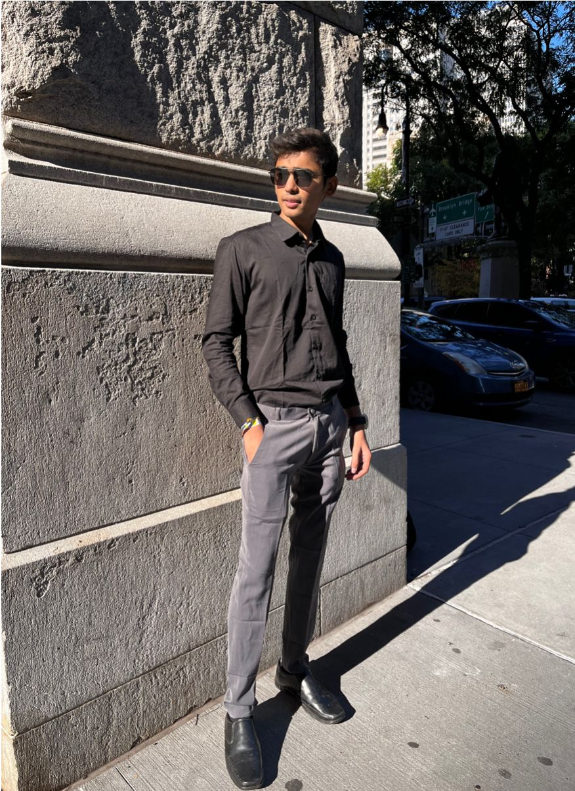

team
Bhavik Chopra
Dhyey Dave
Krushil Sheladiya
Mahesh Nakka
Data Scientist
Developer
Developer
QA Tester

Slide 6



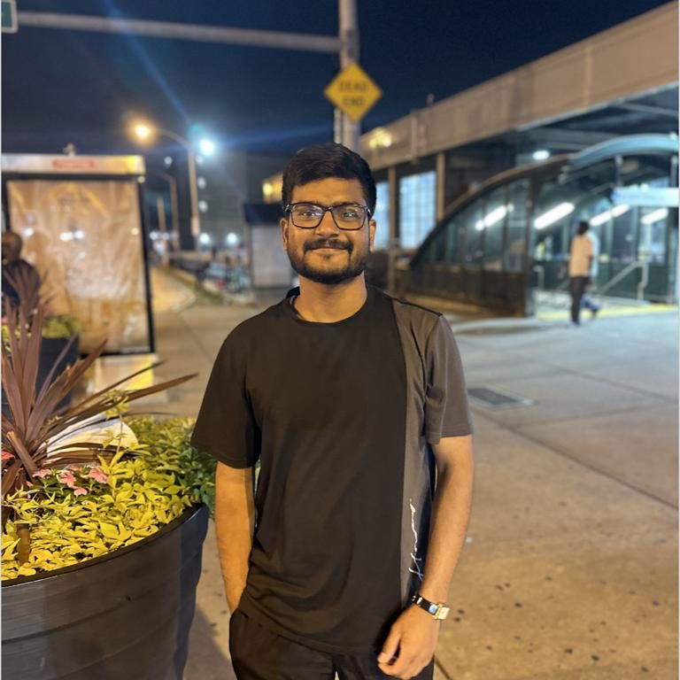
team
Nisarg Bhuva
Shane Parmar
Urmil Trivedi
Vijay Devkate
Scrum Master
Product Owner
Developer
Machine Learning Engineer

Slide 7


personas
Business analysis

Slide 8

Background:
Sarah is a 32-year-old marketing executive who works long hours and travels frequently. She often experiences stress due to her demanding job.
Emotional Profile:
Sarah seeks music as a means of unwinding and finding solace after a hectic workday. She values tracks that induce a sense of calmness and relaxation.
Sarah:
The Busy Professional
Preferred Genres:
Instrumental tracks, Jazz for its soothing melodies, Ambient music for background ambiance, and Calm Pop for its easy-listening qualities.

Slide 9

Background:
Alex is a 27-year-old fitness trainer who is passionate about leading an active lifestyle. He regularly engages in high-intensity workouts to maintain his physical health.
Emotional Profile:
For Alex, music serves as a motivational tool during workouts. He looks for energetic beats and rhythmic tunes that can enhance his performance and keep his energy levels high.
Alex:
The Energetic Fitness Enthusiast
Preferred Genres:
Alex leans towards EDM with upbeat tempos, Hip-Hop for its rhythmic flow, Rock for its adrenaline-pumping vibe, and Upbeat Pop for its lively tunes.

Slide 10

Background:
Mia is a 20-year-old college student majoring in philosophy. She values moments of introspection and often immerses herself in thoughtful activities like reading and studying.
Emotional Profile:
Music is an integral part of Mia's study routine, and she looks for tracks that complement her moods. She prefers music that fosters focus and a calming ambiance.
Mia:
The Reflective College Student
Preferred Genres:
Indie music for its authenticity, Alternative tunes for a diverse sound, Acoustic tracks for their simplicity, and Chill Electronica for a relaxing background.

Slide 11

Background:
Oliver is a 35-year-old artisan who spends his days crafting unique handmade items. His work requires precision and creativity, and he often seeks inspiration through various artistic outlets.
Emotional Profile:
Oliver values music that fuels his creative process. He looks for tracks with eclectic and innovative sounds that inspire his artistic imagination and enhance his focus.
Oliver:
The Busy Professional
Preferred Genres:
Ambient Electronic for its atmospheric sounds, Indie Experimental for its creative diversity, Classical for its timeless inspiration.

Slide 12
Market Analysis

Slide 13
Market Overview:
Increasing demand for personalized content experiences.
MoodSphere offers a unique focus on emotional intelligence, standing out in a competitive music streaming market.
Target Audience:
Appeals to a wide range of demographics including professionals, fitness enthusiasts, and students.
Designed for a global audience, transcending cultural and demographic limits.
Unique Selling Propositions (USPs):
Utilizes facial recognition and advanced algorithms for emotionally intelligent music recommendations.
Dynamically adjusts music recommendations based on real-time emotional changes.
Prioritizes privacy with secure handling of facial data and customizable data sharing options.

Slide 14
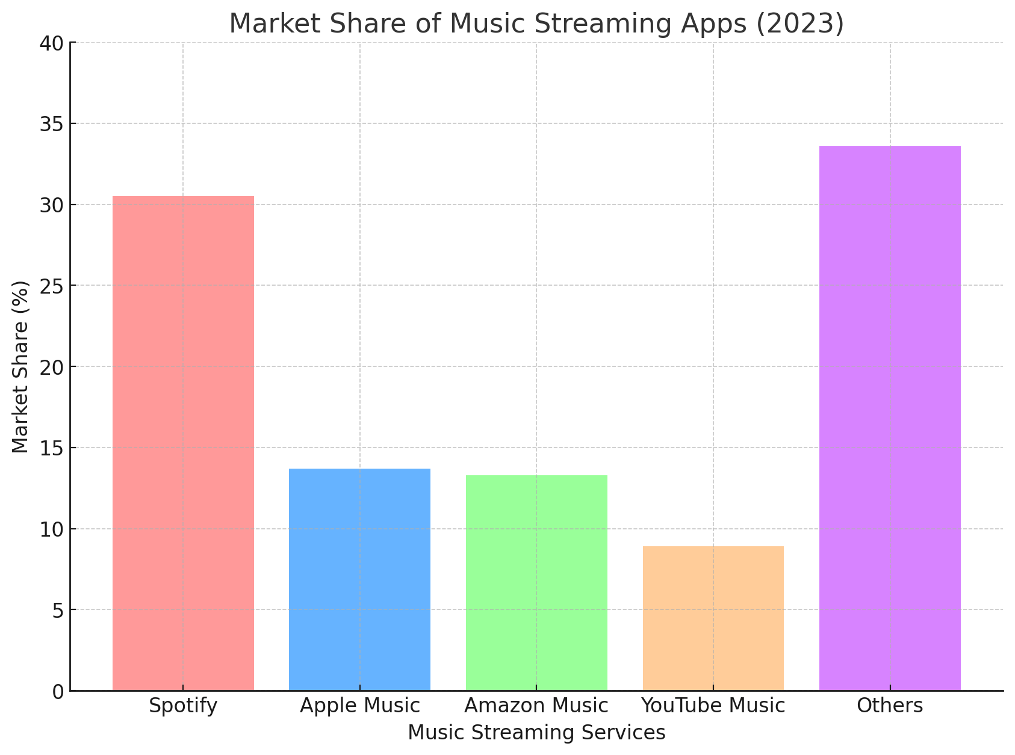
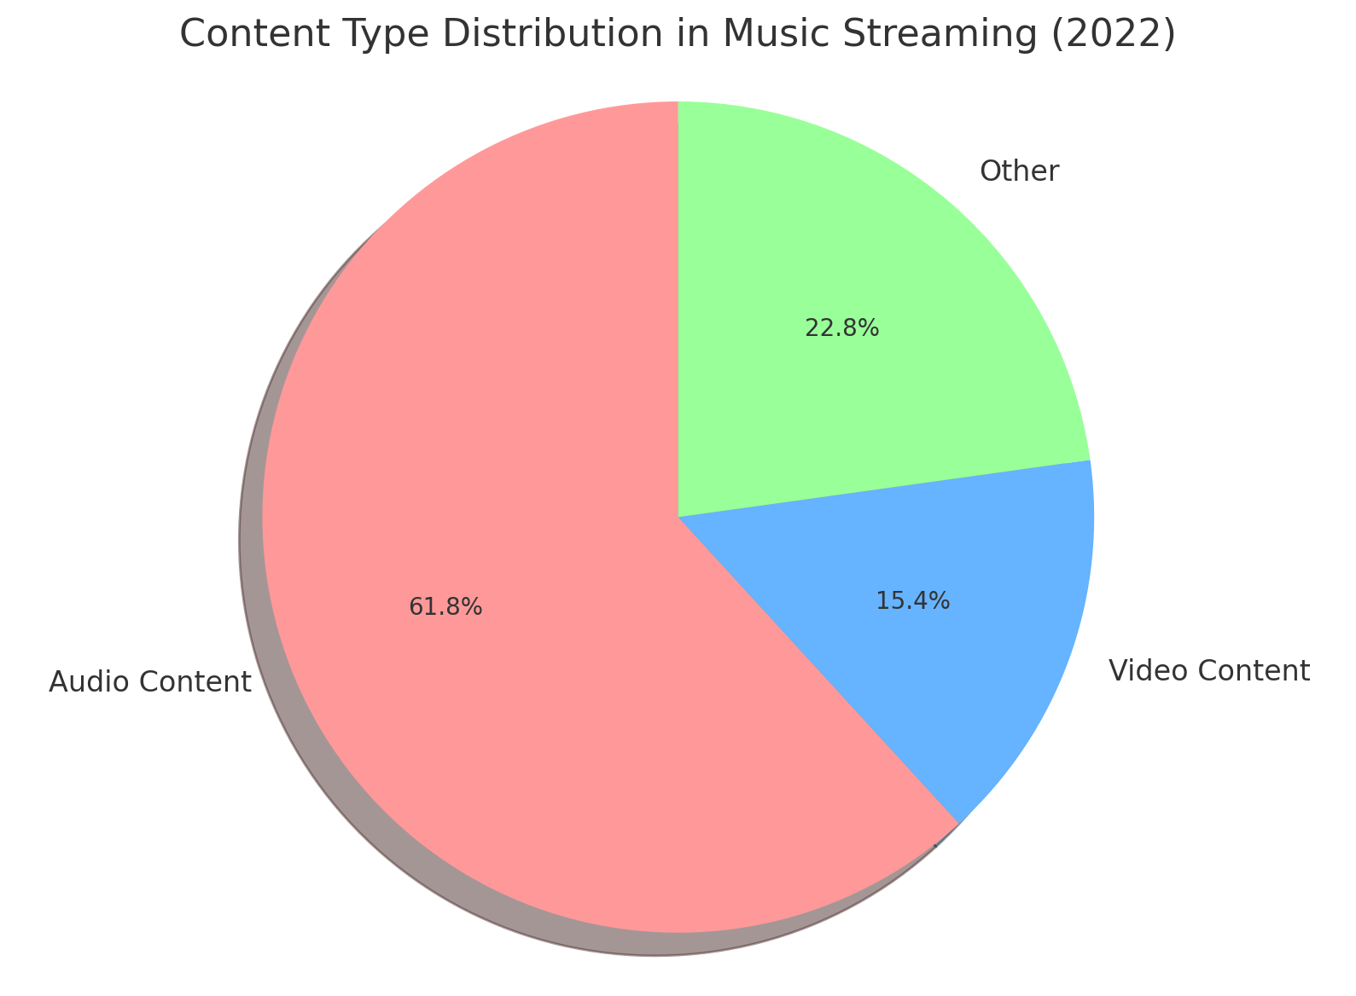
Market Share & DISTRIBUTION

Slide 15
Market Challenges

Slide 16
User Adoption Concerns:
Potential hesitations around facial recognition for emotional analysis highlight the need for clear, reassuring communication regarding privacy safeguards and consent-based engagement.
Navigating Established Rivals:
Transitioning users from entrenched platforms to MoodSphere demands strategic marketing initiatives that clearly articulate its distinctive advantages and emotional intelligence capabilities.
Market Approaches:
Targeted Social Media Initiatives:
Utilize social media channels for brand visibility, sharing compelling user experiences, and interacting with the community. Employ precise ad targeting to engage with niche markets and demographics.
Introductory Offers and Incentives:
Implement introductory experiences or time-sensitive incentives to invite new users to discover the application's unique value proposition, cultivating initial trust and long-term engagement.

Slide 17
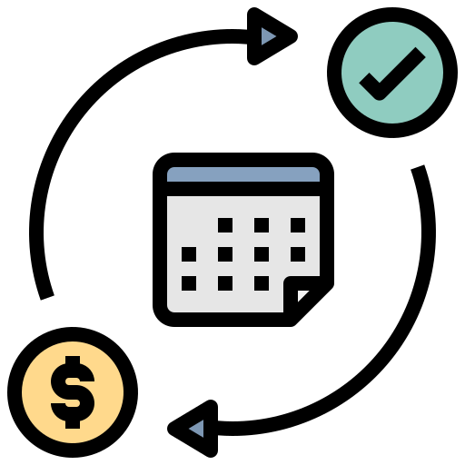


Monetization
Subscription
In-App Purchases
Ad-Support
Introduce a premium subscription tier with advanced features, such as unlimited access to a broader music catalog, offline listening, and exclusive emotional playlists.
Offer tiered subscription plans with varying levels of personalization and additional perks for premium subscribers.
Offer in-app purchases for exclusive emotional playlists curated by renowned artists, influencers, or expert curators.
Provide users the option to buy special edition emotion-based playlists for specific occasions or moods.
Implement a free, ad-supported version of the app with occasional advertisements between songs for users who prefer not to subscribe.
Offer an ad-free experience as a premium feature for subscribers.

Slide 18

The way to get started is to quit talking and begin doing.
Walt Disney

Slide 19
timeline
BrainStorming Ideas
Collaborate generate and discuss potential project ideas that align with your team's interests and skills.
Making Teamwork Agreement
Establish clear communication channels, define roles and responsibilities, set expectations for collaboration, and agree on project timelines.
Setting up Jira and Assigning Tasks:
Utilize Jira to create a project board, define tasks, and assign responsibilities. This helps in organizing and tracking the progress of each team member.
Start working on project by gathering all the requirements and testing different suitable resources for whole project and for this week's deliverable 1
Collaboratively start working on Deliverable 1 based on the gathered requirements and finalize each other's work to finish deliverable-1
Project Kickoff and Requirements Gathering for Deliverable-1:
Working and finalizing Deliverable-1 presentation

Slide 20
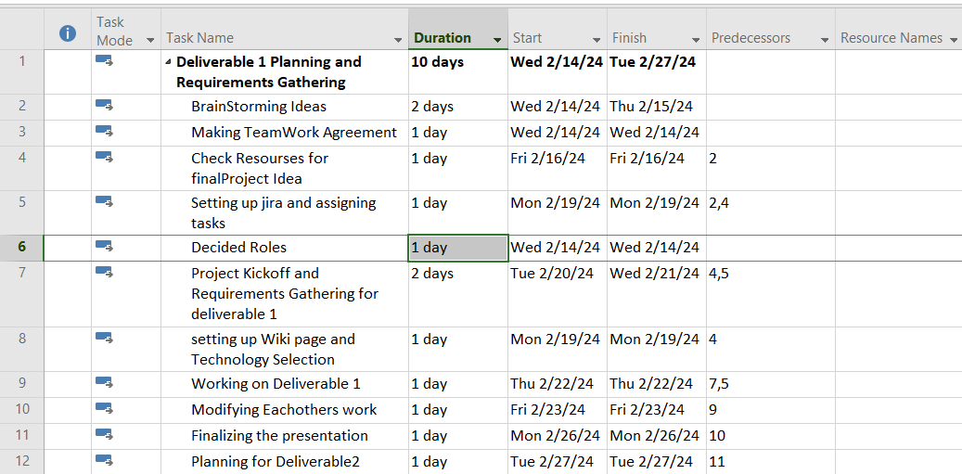
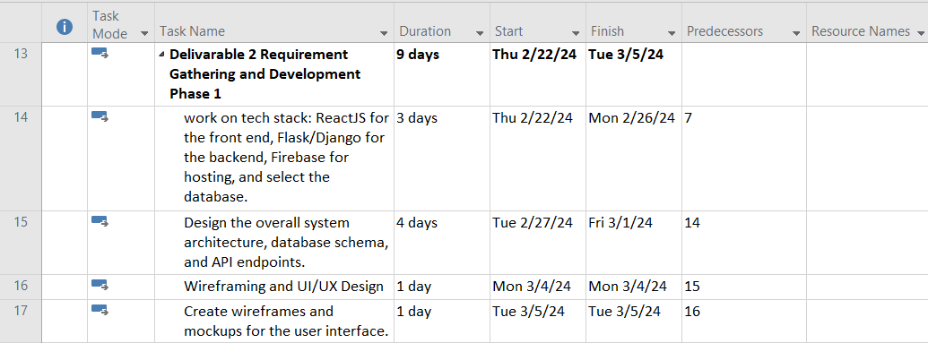
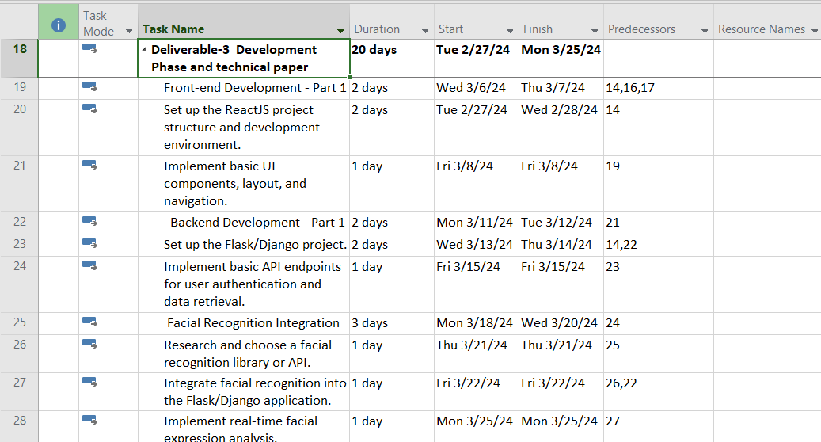
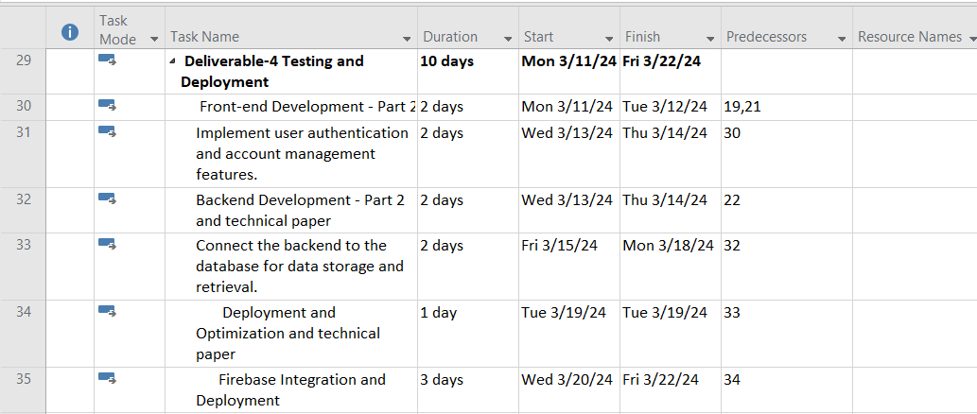
Project planning

Slide 21
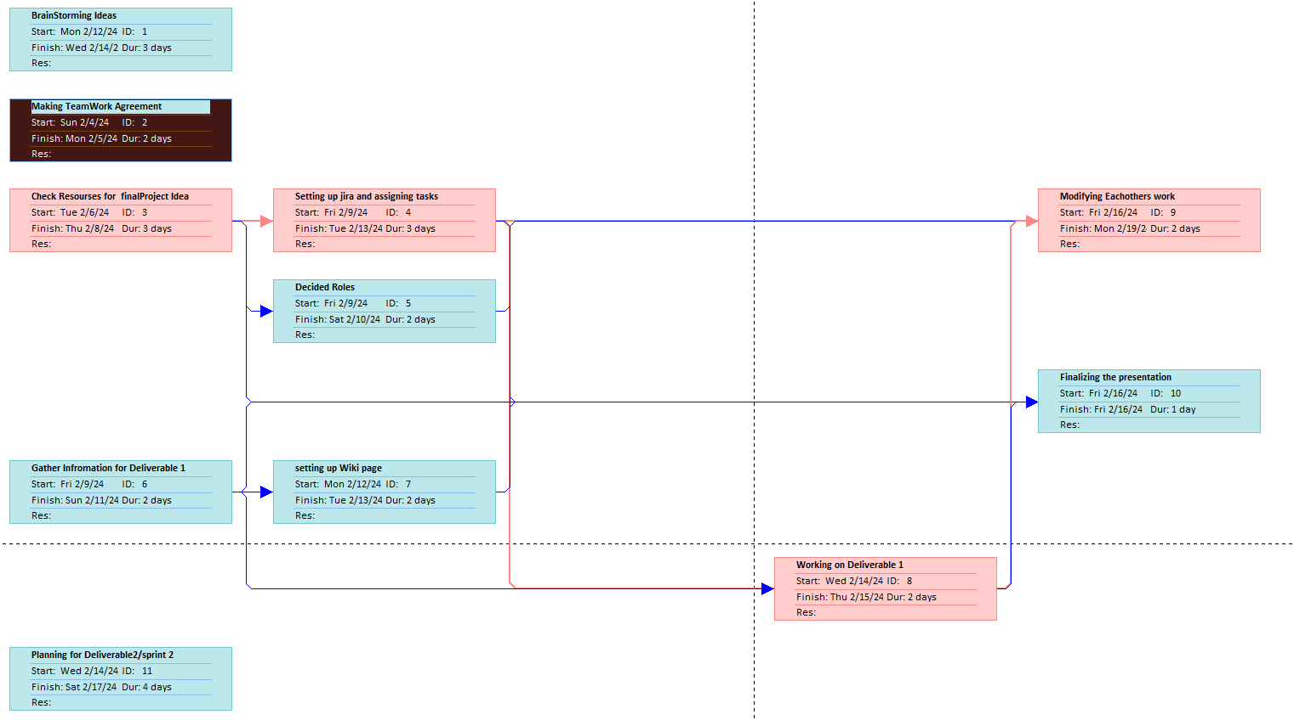
Deliverable-1 planning

Slide 22








Technologies
Tensorflow
React
Firebase
Python
HTML
CSS
Django
Jira

Slide 23
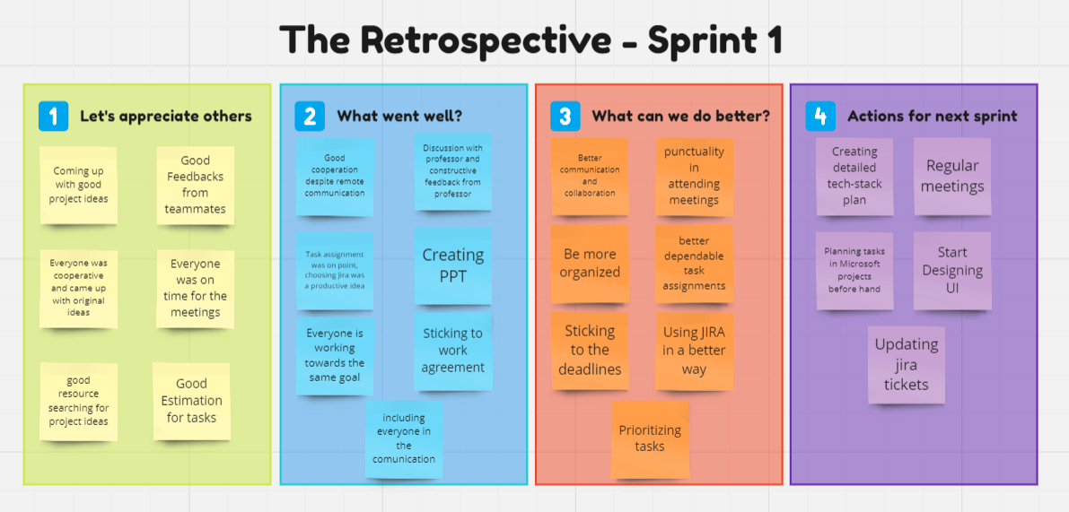

Slide 24
Retrospective
What went well?
What can we do better?
What we plan to commit for next sprint?
As a team, we successfully adhered to a simplified set of objectives, by dividing tasks ensuring the timely completion and delivery of the expected project outcomes.
The team experienced positive collaboration and effective teamwork throughout the sprint, fostering a good working environment.
Every member of the team demonstrated proactive engagement, actively participating in tasks with clear and thoughtful contributions.
We engaged in multiple zoom sessions to address various aspects of the project keeping the minute details on point.
Throughout every meeting session, our primary focus was on making progress and ensuring the timely completion of sprints and deliverables.
By selecting Jira, the team likely experienced enhanced productivity, streamlined communication, and efficient progress monitoring throughout the task assignment process.
We achieved our goal for Sprint 1, however we feel that we could've had better communication and collaboration.
Using Jira to the most would have been a plus.
Prioritizing tasks and being organized would have enhanced our productivity towards our goal.
Sticking to deadlines would have helped us finish tasks ahead of time.
Punctuality to meetings would have been a plus.
For the next sprint, our key commitments include enhancing collaboration tools, addressing feedback from individual team members about every tasks. Additionally, we plan to conduct a thorough review of our development process to identify areas for efficiency gains.
The team is committed to maintaining a high level of communication and adaptability to ensure successful outcomes in the upcoming sprint.
Start designing the User Interface of our project.
Regular meet-ups and updating Jira tickets.

Slide 25
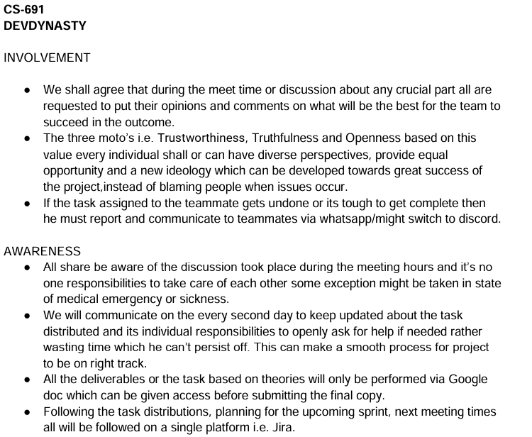
TEAMWORK Agreement

Slide 26
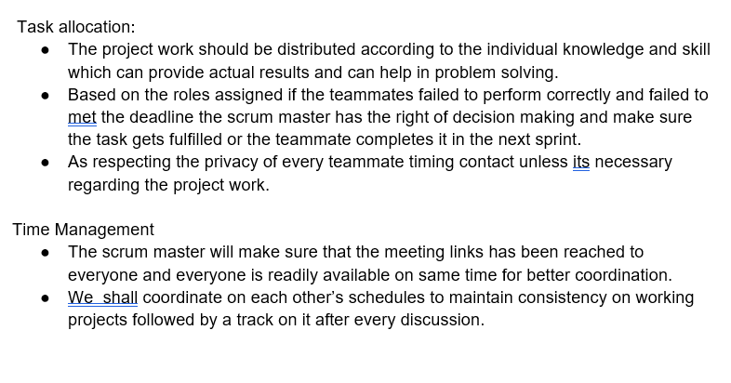
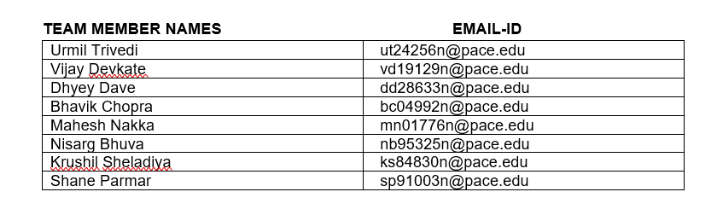
TEAM WORK AGREEMENT

Slide 27


Summary
MoodSphere is an Emotion-Based Music Recommender that can be implemented by using Facial Recognition and Convolutional Neural Networks (CNN) that overcomes the constraints of conventional music streaming services by employing cutting-edge computer vision technology. Apart from the other comprehensive recommendation algorithms, our project mainly focuses on emotional based features and its relevance to recommend consumers' based on their emotional state. The reasons why we chose CNNs and facial recognition technology is to precisely evaluate users' facial expressions to emotional cues. The main motive is to tailor music suggestions by combining powerful machine learning algorithms with visual data that will be captured, therefore improving their entire listening experience.

Slide 28
Wiki page link
Home · htmw/2024S-Dev-Dynasty Wiki (github.com)

Slide 29

Thank you
DevDynasty

